Slide 1

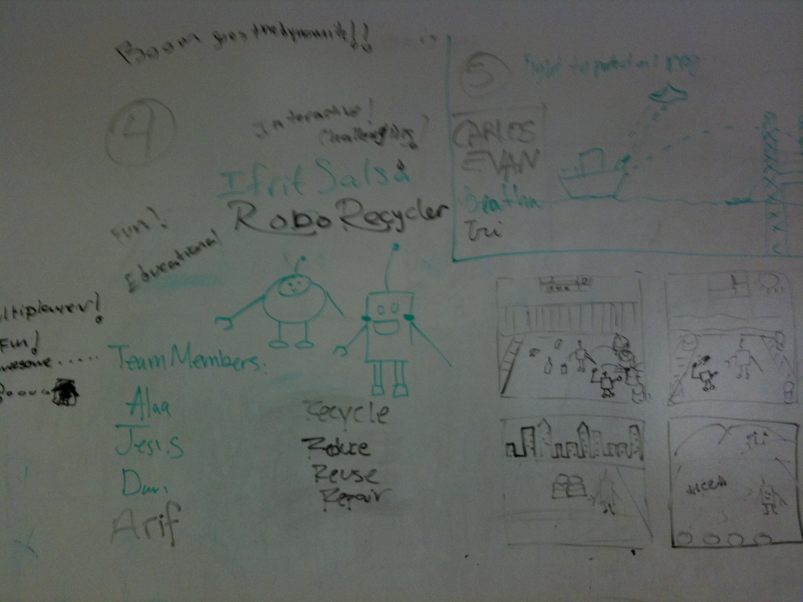
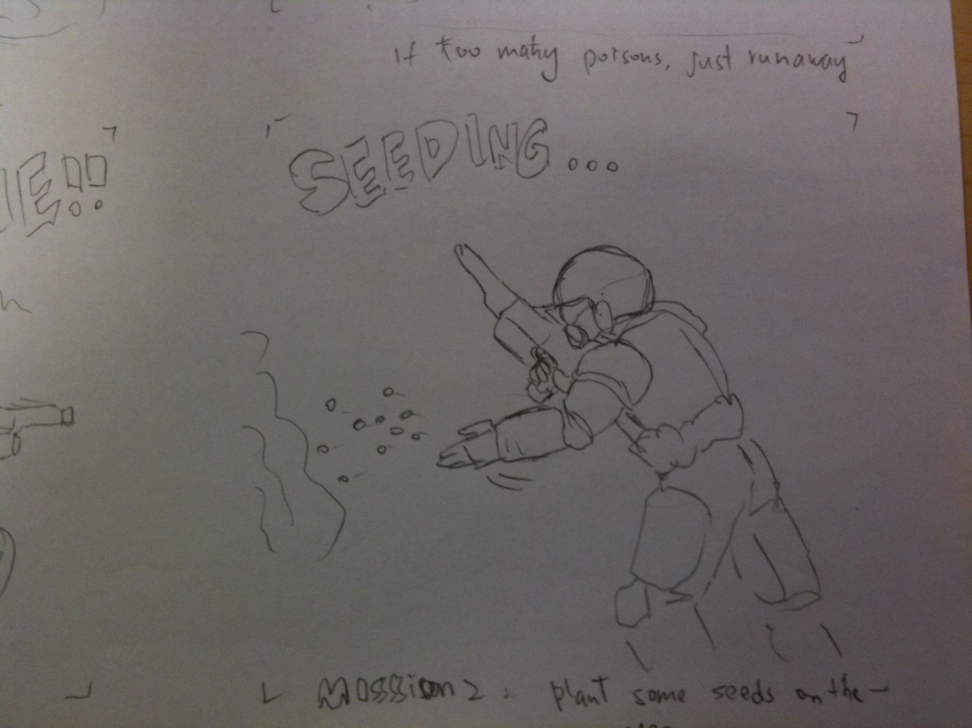
gaming design
RoboRecycler
Two teams from the University of Houston are among 10 finalists in a national computer game design competition sponsored by Microsoft.
Antitoxin Squad
The eight computer science students have earned an all-expense paid trip to Washington, DC on April 23 where they will vie for a grand prize of $8,000, with hopes of advancing to the finals in Poland for a grand prize of $25,000.

Slide 2


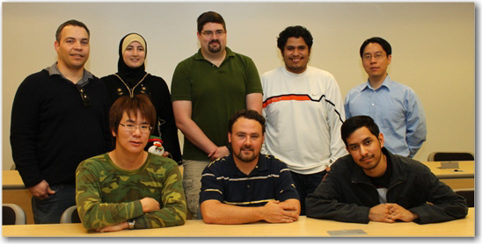
The two teams choose a name!
To foster team spirit, they needed creative names for their teams!
Per team graduate, Reggie Tye:
Per team graduate, Daniel Biediger:
“Our team submitted names and had a vote. Level 13 won the vote. The number 13 in some cultures is associated with bad luck, but we chose it because it can also be used to represent something that is unattainable (i.e. the perfect game). It helps us to work harder and strive for perfection.”
“One teammate came up with the name Ifrit and then we all came up with the name Salsa, of course, because it’s Texas. You have a lot of ingredients in salsa and there’s lots of ingredients that go into the game. A salsa that’s so hot that only a fire demon in Ifrit could eat it.”
Standing: Jose Baez-Franceschi, Instructor for Level 13, Alaa Gharandoq; Daniel Biediger; Jesus Hernandez (Team members for Ifrit Salsa), and Dr. Chang Yun, Instructor for Ifrit Salsa. Not pictured: Ifrit Salsa team member Arifur Sabeth
Sitting: Yu-Chao (Alan) Chen, Reggie Tye, Paul Diaz (Team members for Level 13). Not pictured: Level 13 team member Syung (Tom) You

Slide 3
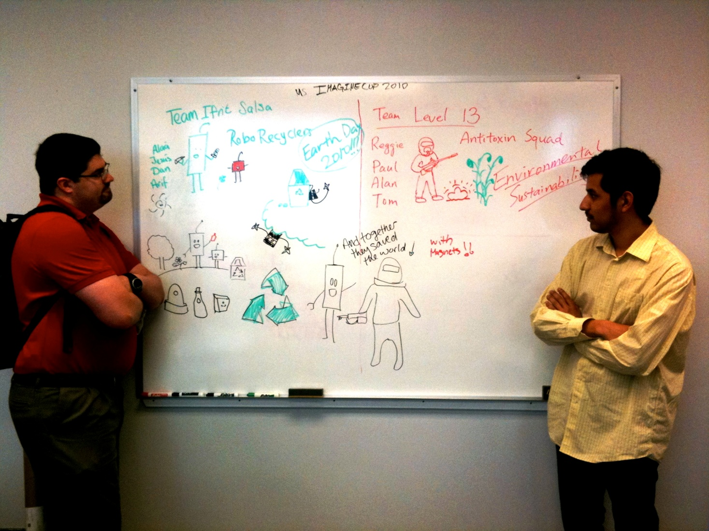
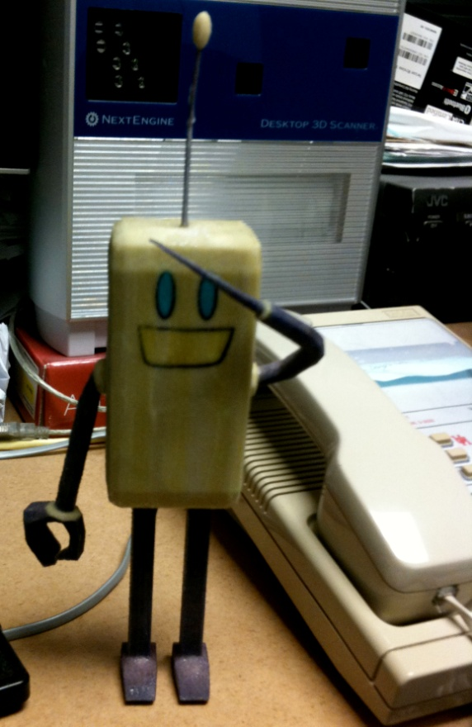
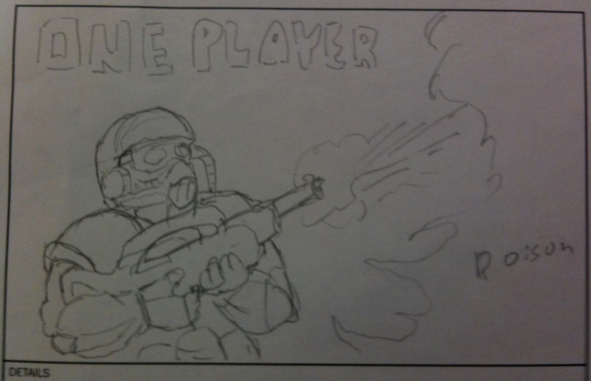
RoboRecycler
seeks to teach youngsters that recycling is easy and fun.
Antitoxin Squad
‘s goal is to destroy pollution through bioremediation.

Slide 4
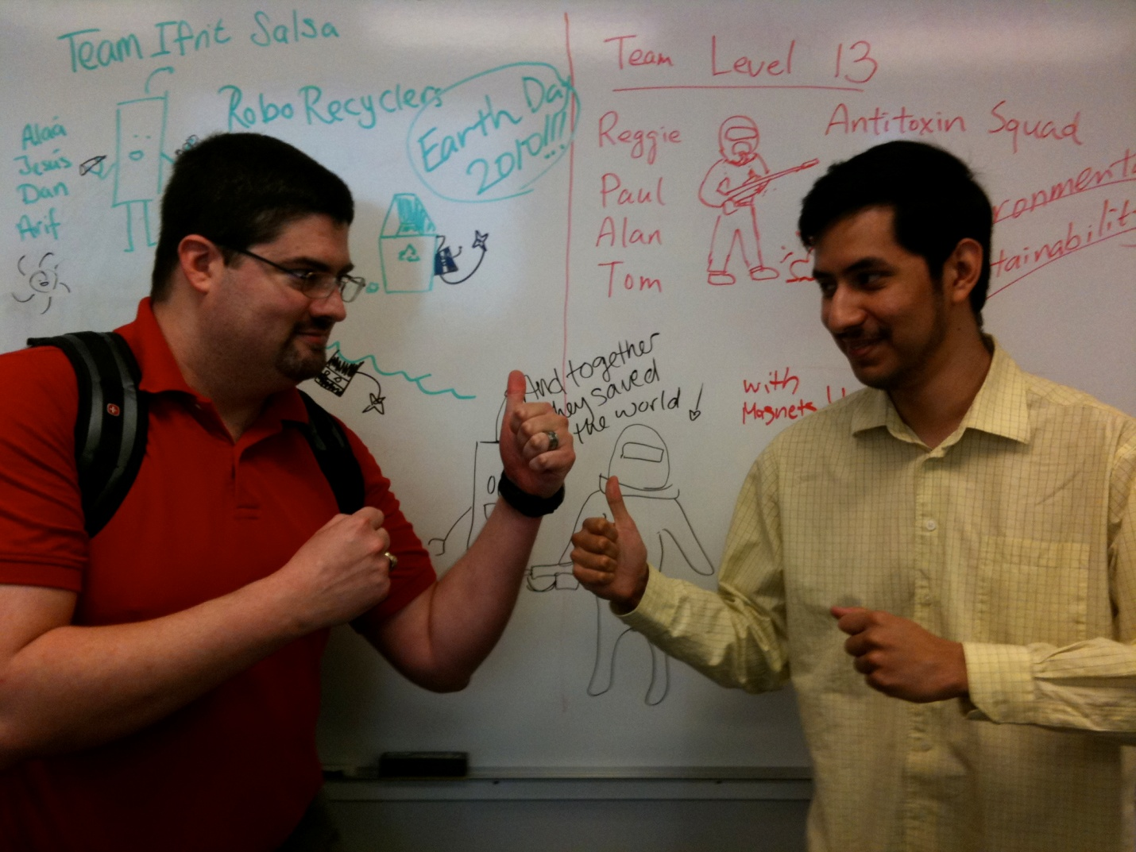

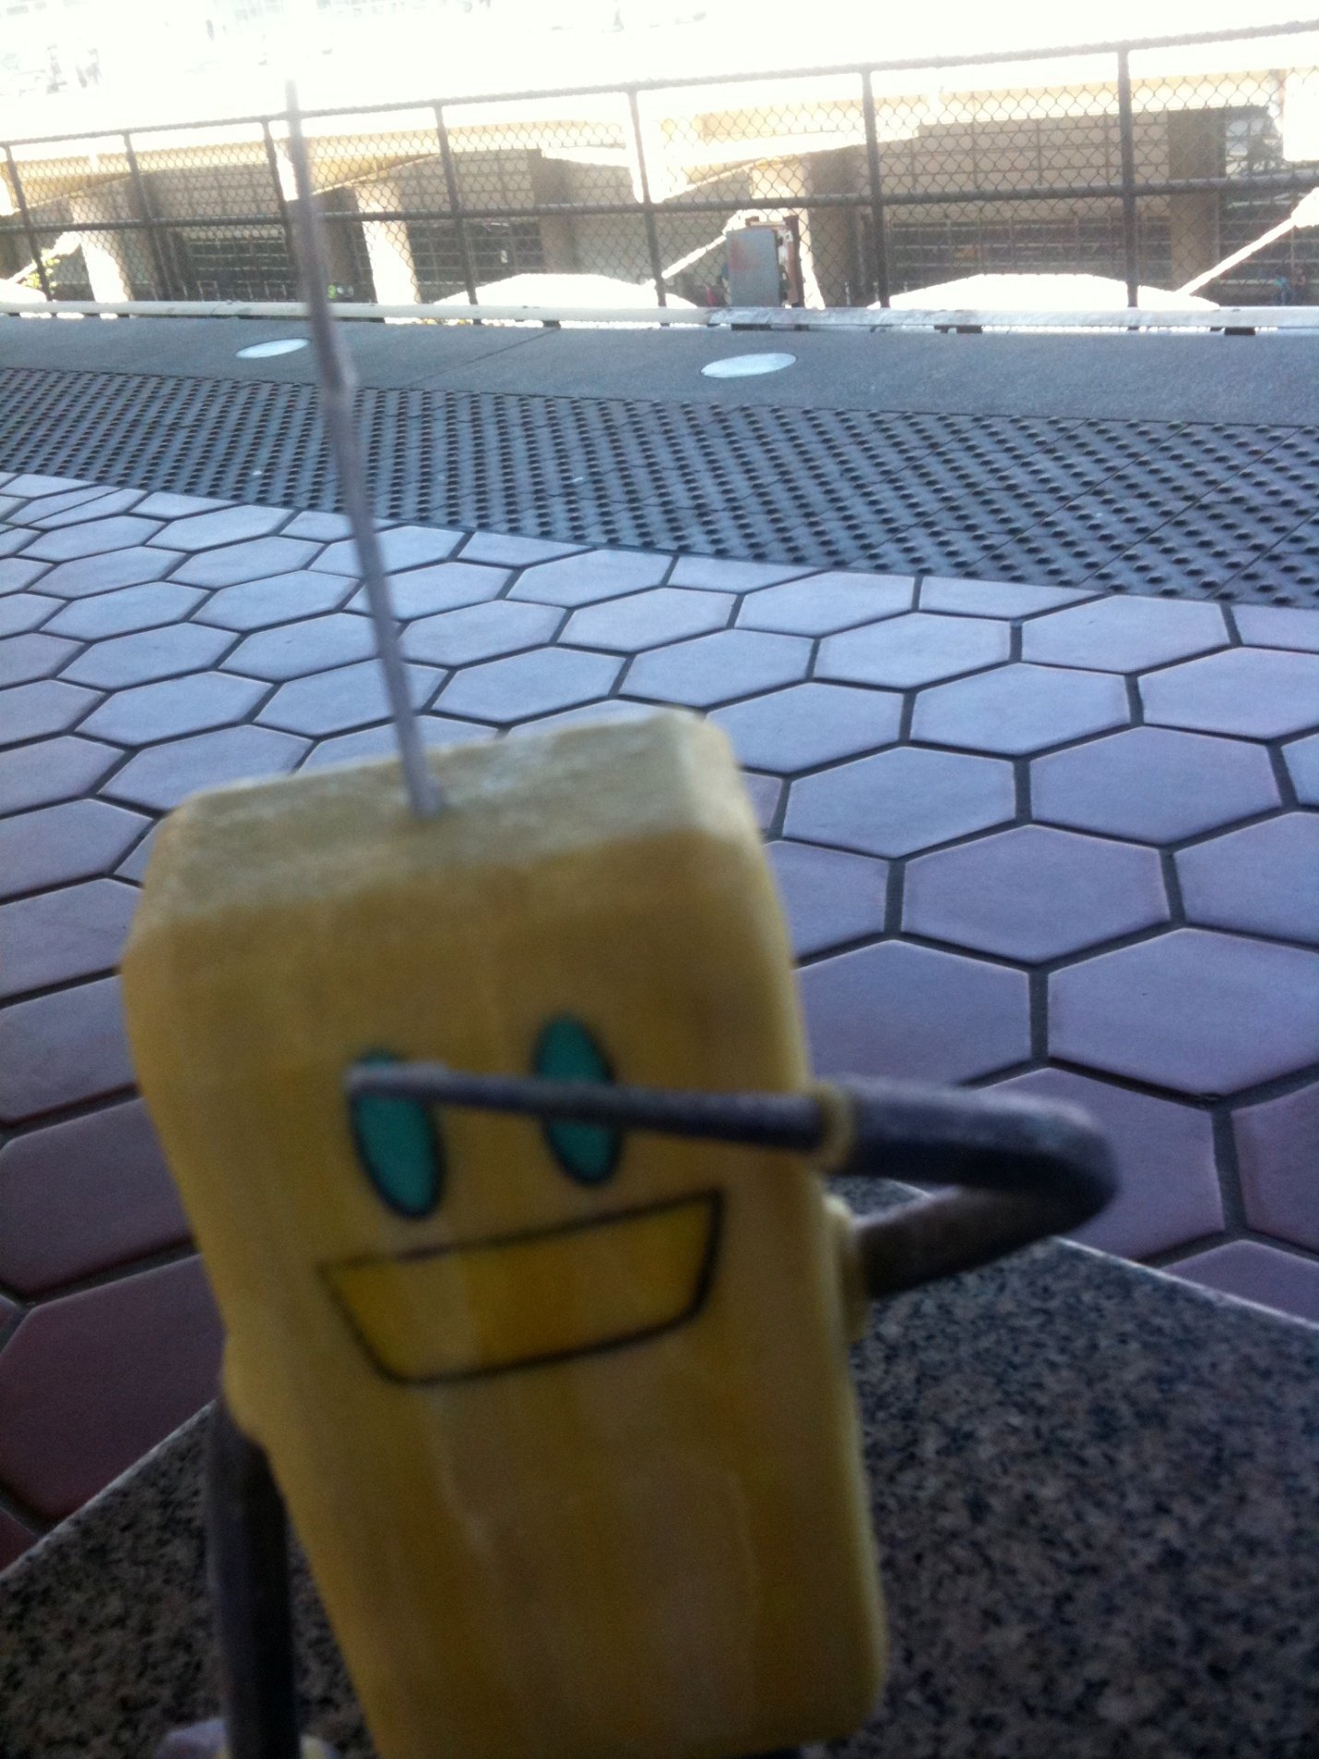
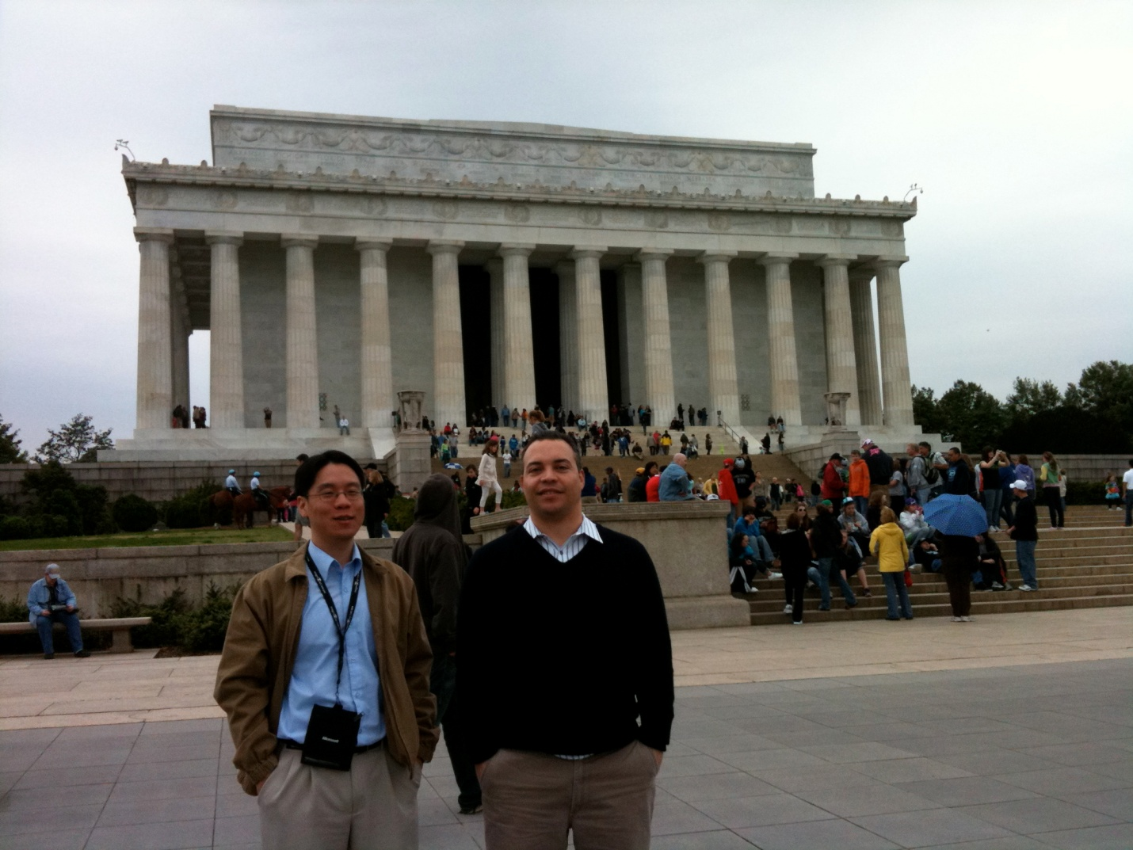
Teams Ifrit Salsa and Level 13
goes to Washington, D.C. for the
Imagine Cup 2010
US Competition
Daniel Biediger
Ifrit Salsa
Paul Diaz
Level 13
RoboRecycler
Instructor for Ifrit Salsa,
Dr. Chang Yun
Instructor for Level 13
Jose Baez-Franceschi

Slide 5
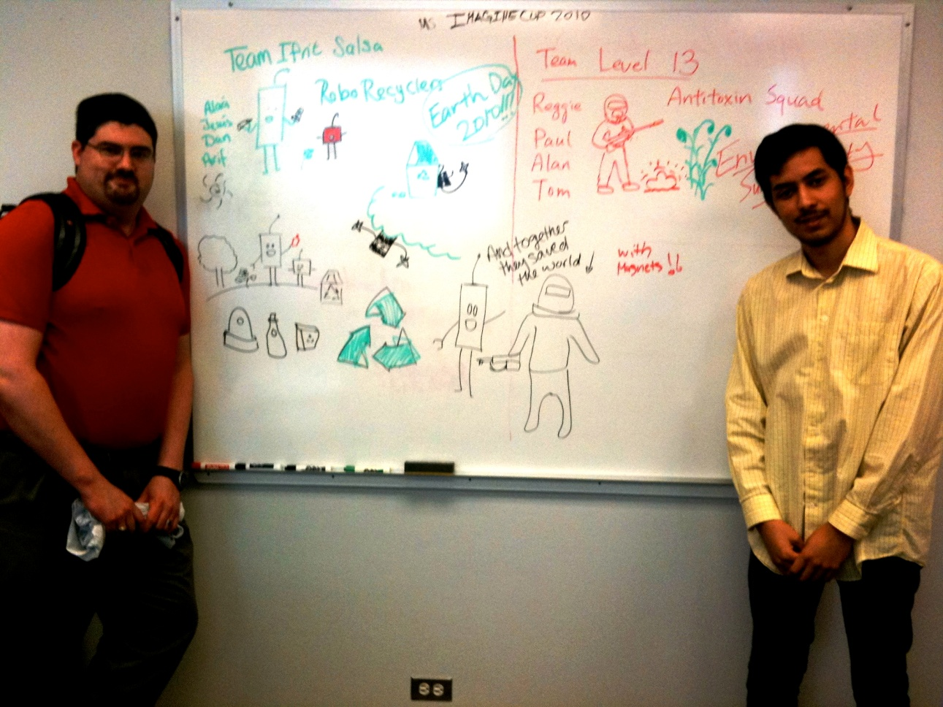

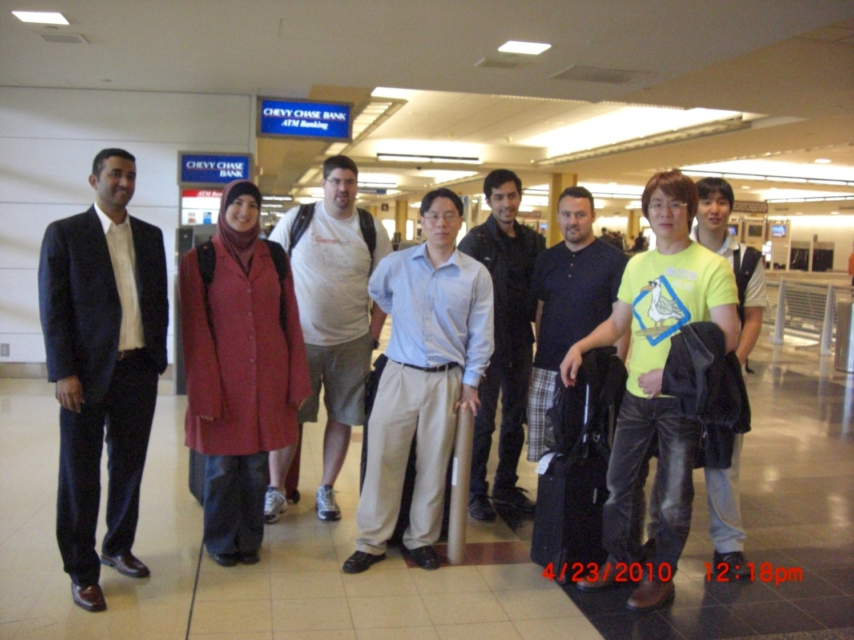
The Imagine Cup is an annual competition that draws thousands of the world’s brightest young techies who vie in several software categories, including game development. The very best will compete in the International Imagine Cup later this year in Poland.
Washington, DC

Slide 6
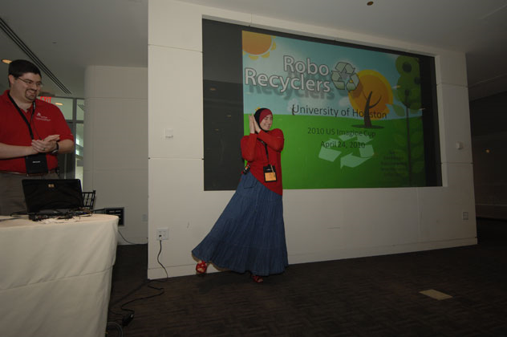
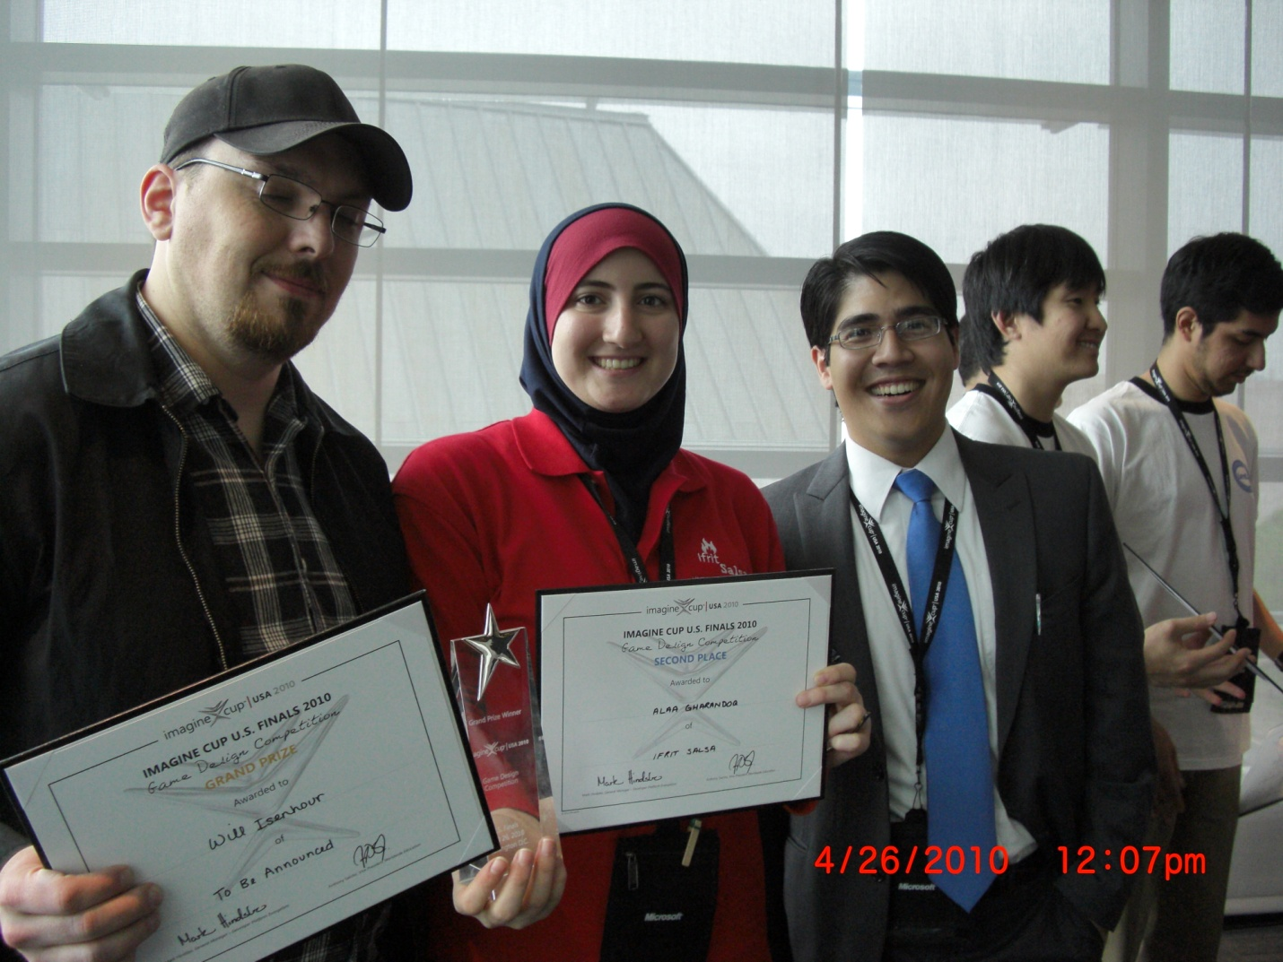
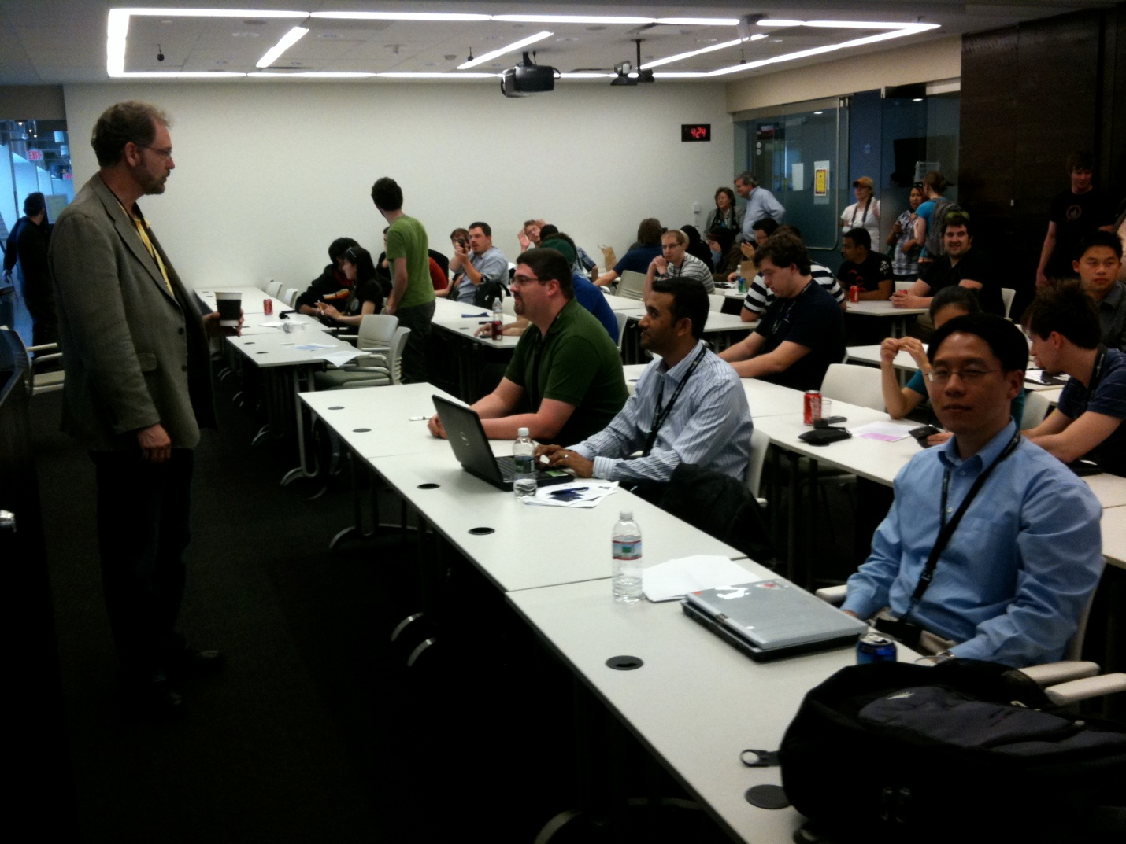
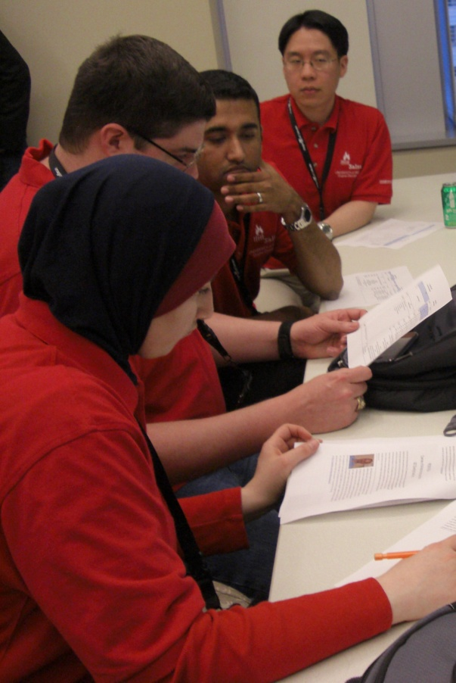
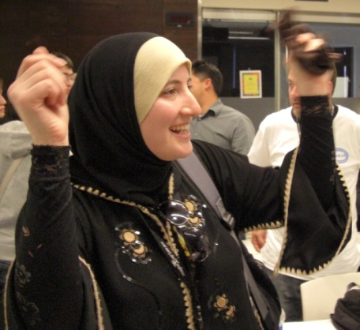
Ifrit Salsa, demonstrates their game, RoboRecycler, at the 2010 Imagine Cup competition in Washington, D.C.
Alaa Gharandoq accepting Second Place for Ifrit Salsa
Dr. Bradley Jenson
Microsoft
Ifrit Salsa Team showing
off their skills!
UH Team Ifrit Salsa is composed of Computer Science graduate student Daniel Biediger and undergraduate students Alaa Gharandoq, Jesus Hernandez, and Arifur Sabeth.

Slide 7
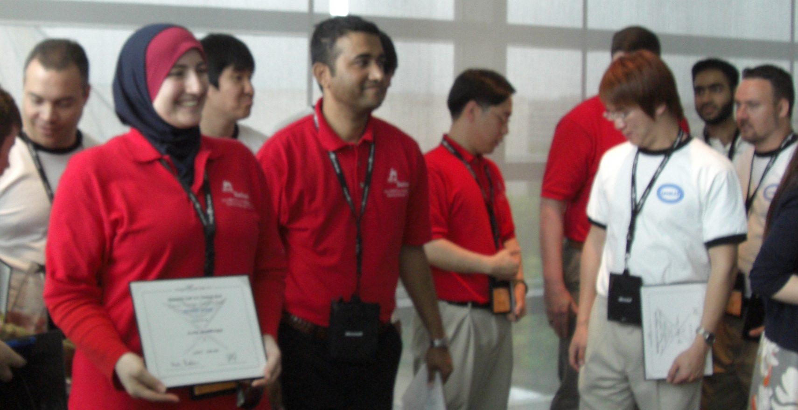
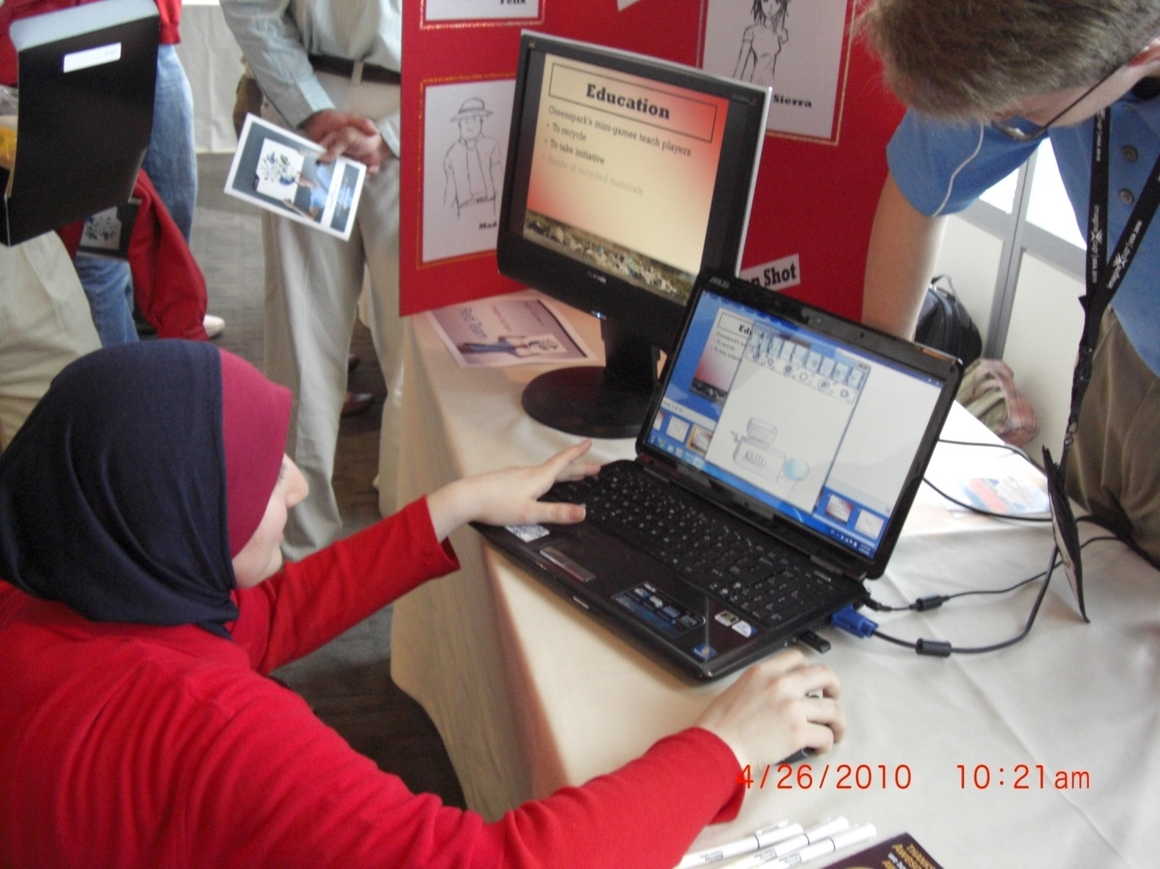
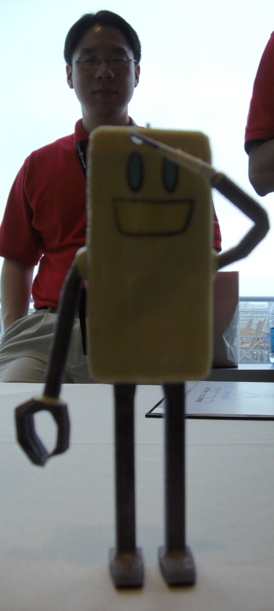
DEMONSTRATE/EDUCATE

Slide 8
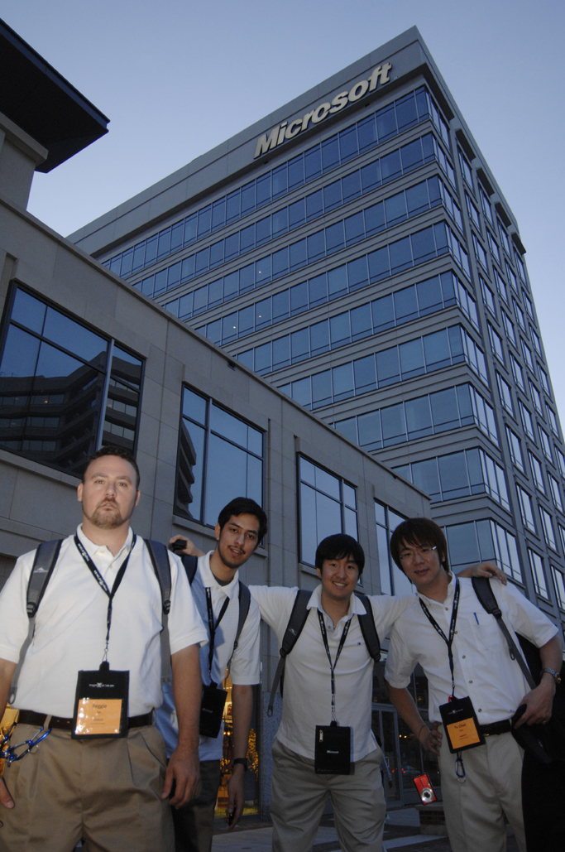
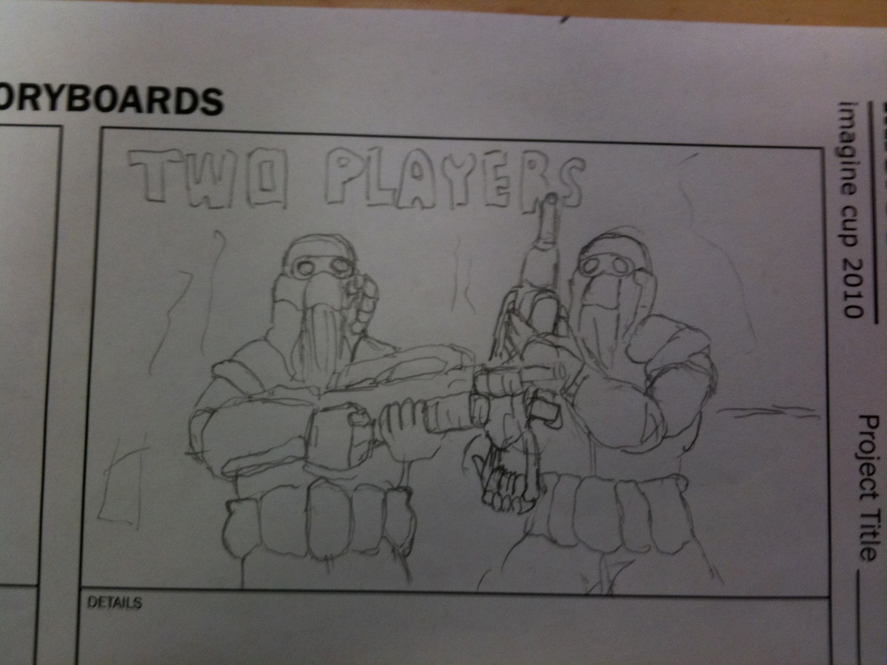
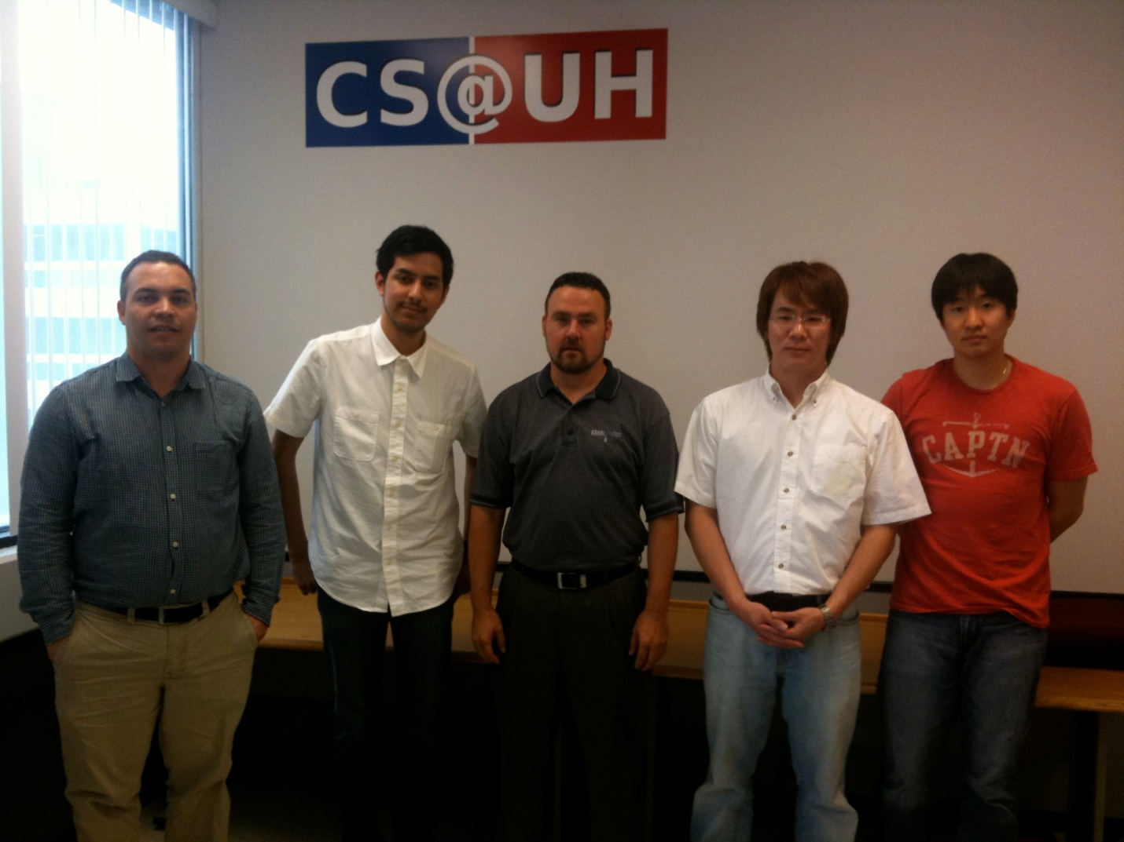
“Imagine a world where
technology helps solve
the toughest problems”
Antitoxin Squad
Mentor –Mr. Jose Baez-Franceschi ,Paul Diaz, Reggie Tye, Alan Chen, and Tom You
THIRD PLACE WINNERS!

Slide 9
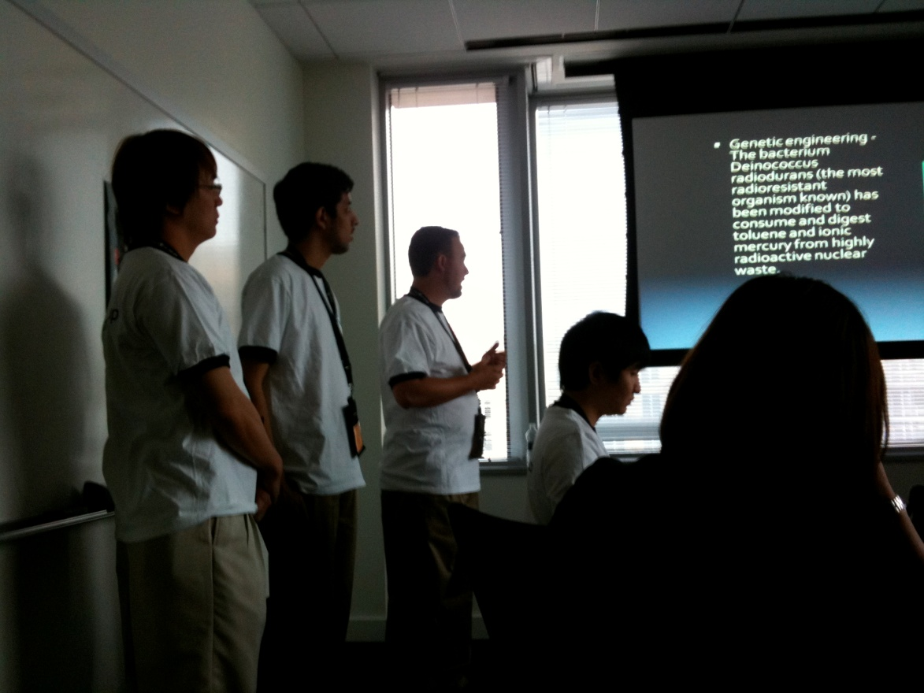
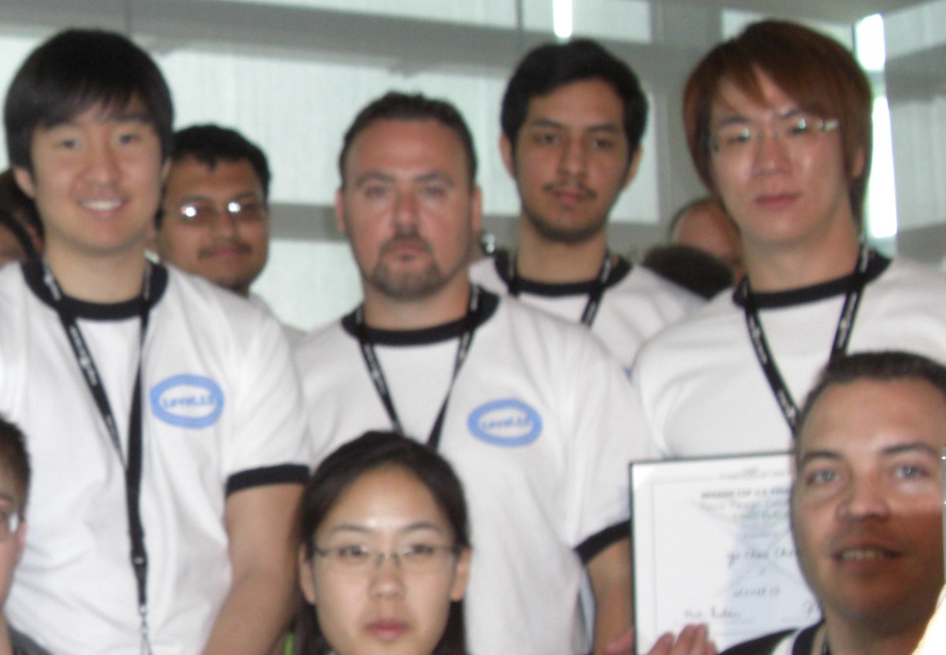
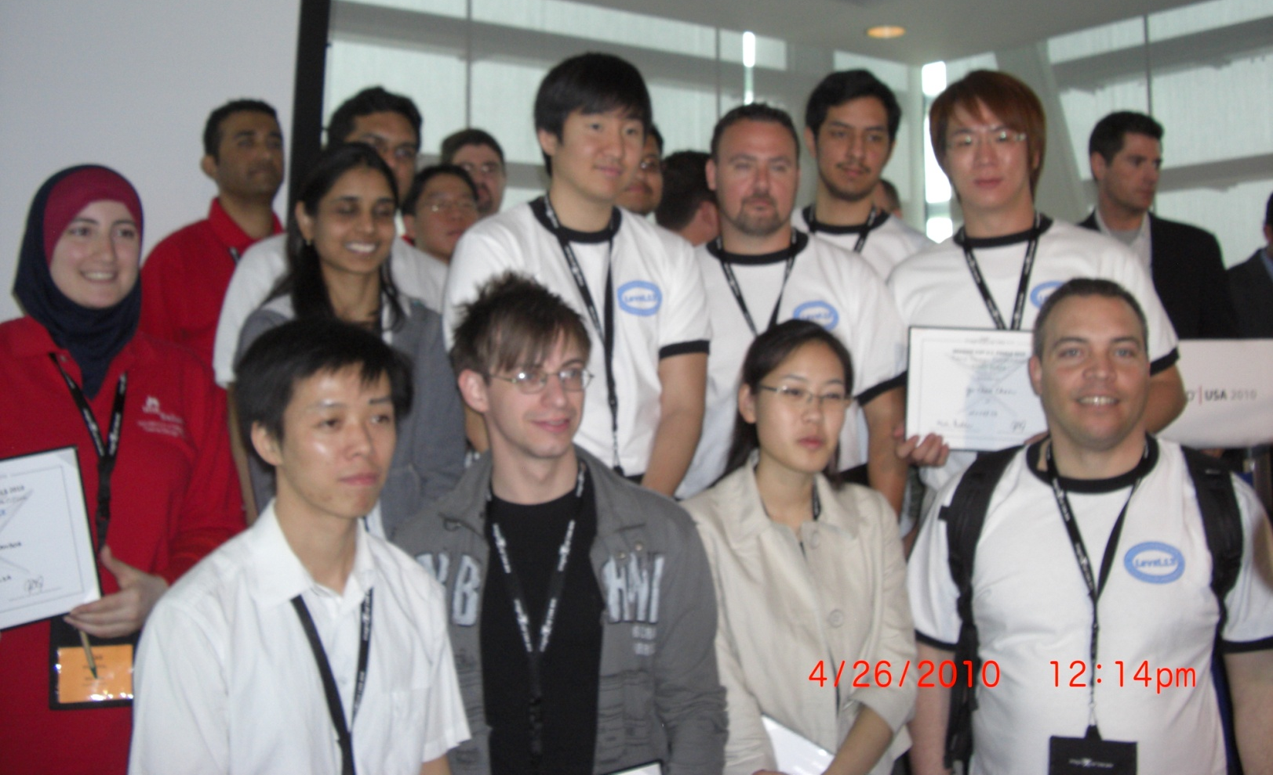
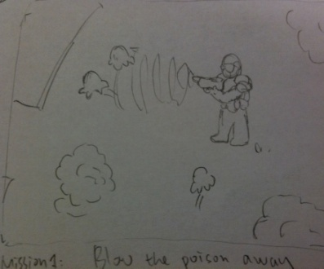
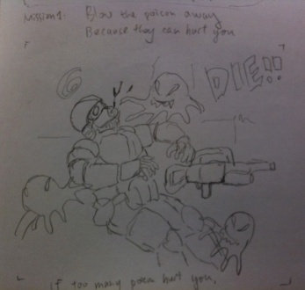
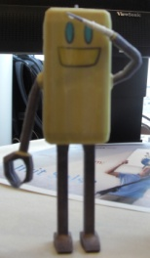
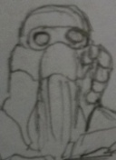
presentation
The National’s Top Four Teams!

Slide 10
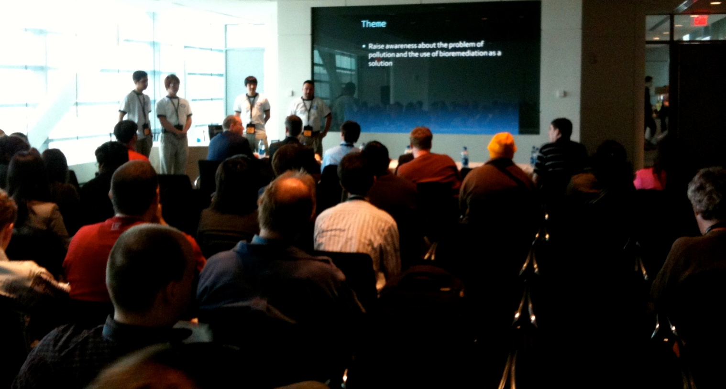
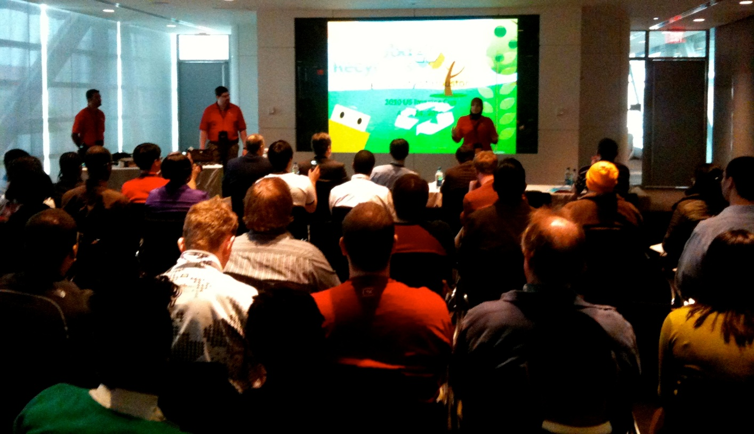
Everything that the world may become "someday" lies in the hands of young people today. As they look at the road ahead, their close relationship with technology enables them to dream in ways we never have before. Put the two together, and you have young minds holding the tools that can make their vision a reality.
This is the recipe that inspired Microsoft to create the Imagine Cup. What begins with a burst of inspiration and a lot of hard work can become a future software breakthrough, a future career, or a flourishing new industry. The Imagine Cup encourages young people to apply their imagination, their passion and their creativity to technology innovations that can make a difference in the world – today.
-Microsoft-

Slide 11
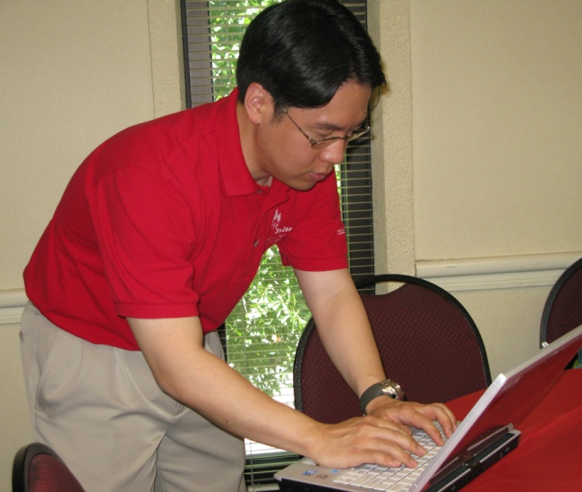
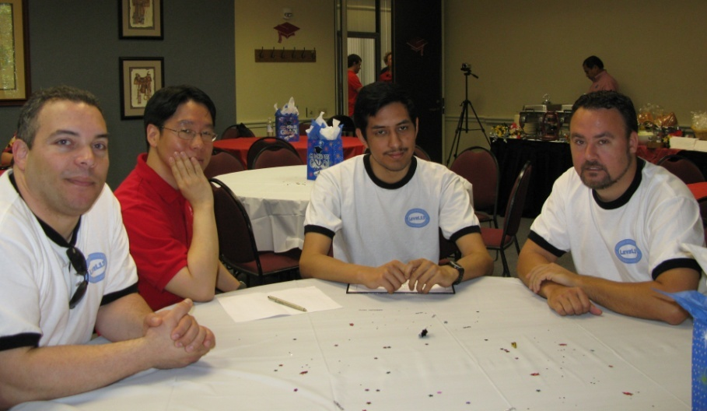
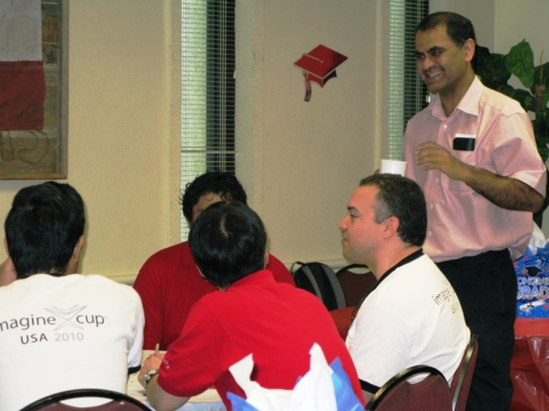
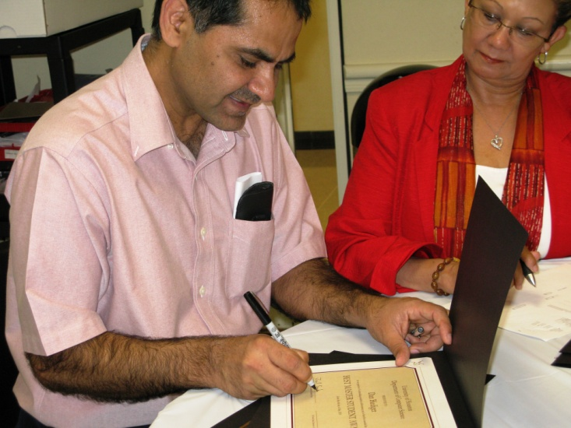
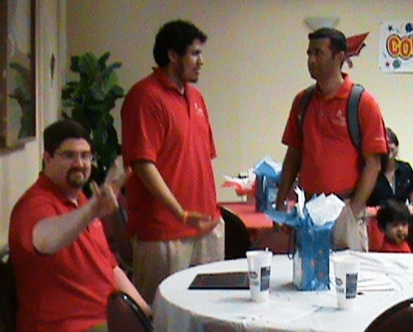
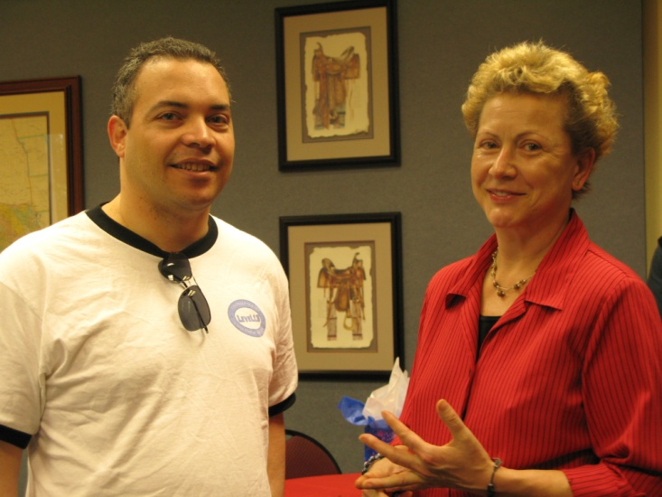
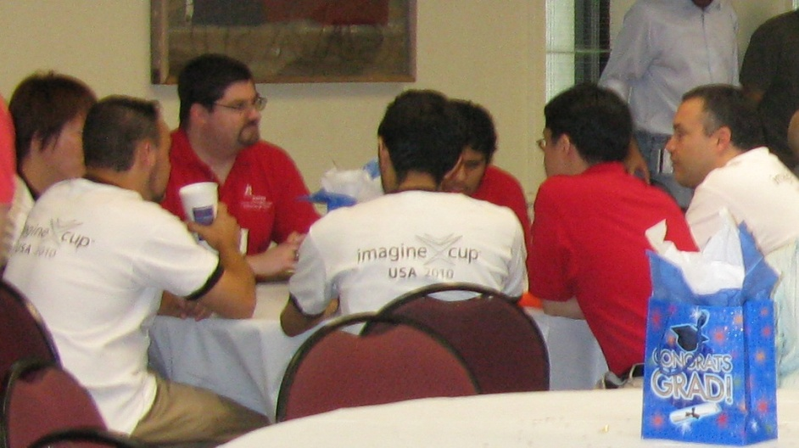
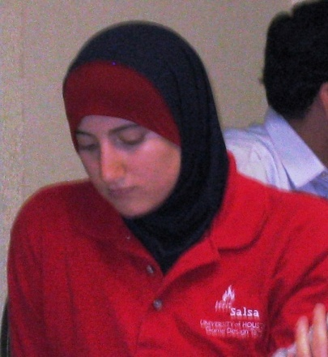
Celebrating at the Graduates Luncheon 2010 for Computer Science
Instructor Ifrit Salsa:
Dr. Chang Yun
Two University of Houston computer science teams placed in the top four in the national game development competition sponsored by Microsoft
Dr. Jaspal Subhlok, Chair
Barbara M. Murray, DBA
Instructor Level 13: Jose Baez-Franceschi
Dr. Victoria Hilford

Slide 12
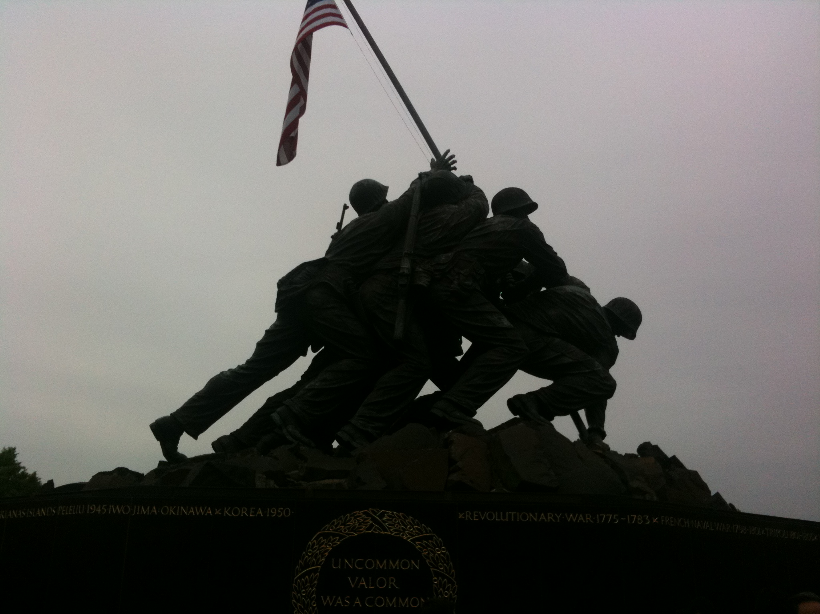
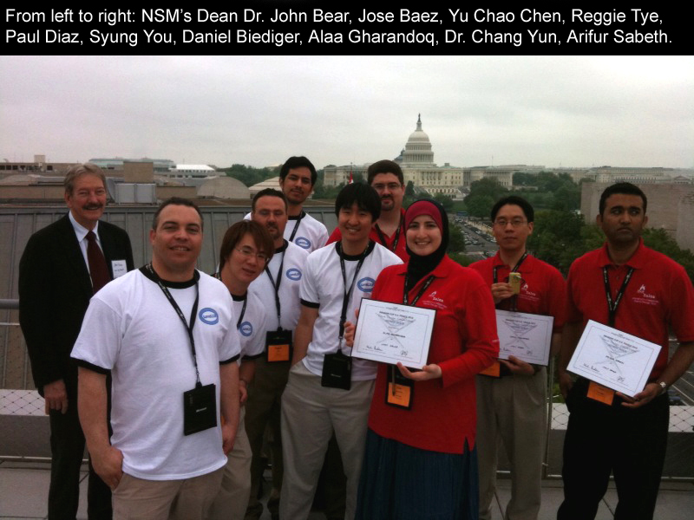
UH students have excelled in game development, and the Computer Science Department was among the first in the nation to offer these courses.
Team Level 13 and
Team Ifrit Salsa

